Slide 1

Part 2: Data Streaming with Kafka

Slide 2
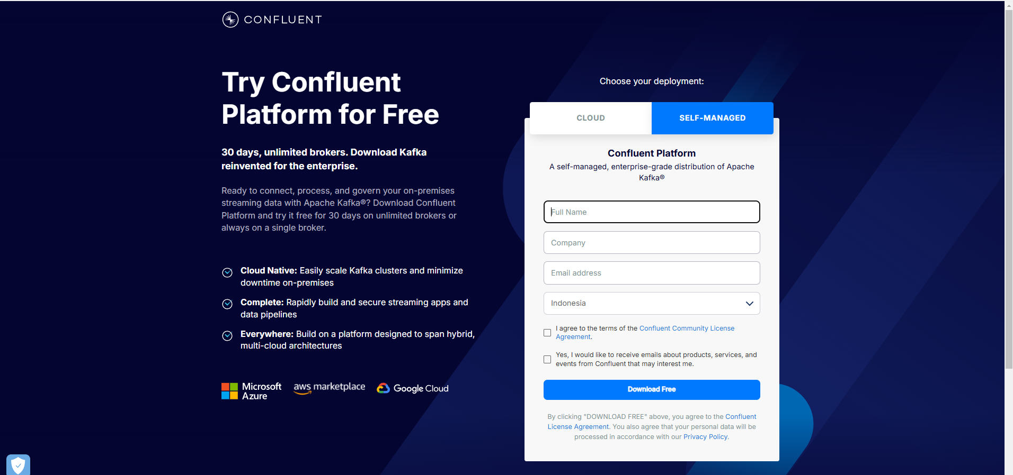
Register Confluent Platform

Slide 3
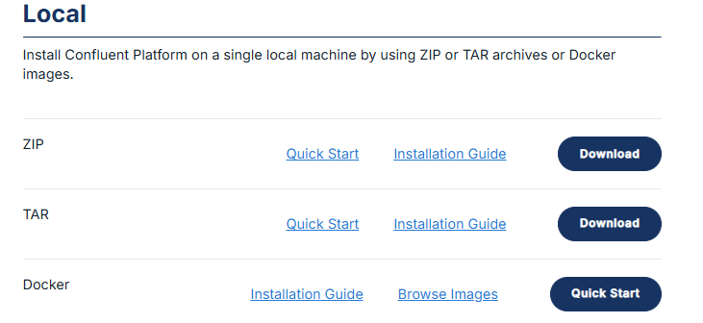
Download Confluent ZIP Files

Slide 4
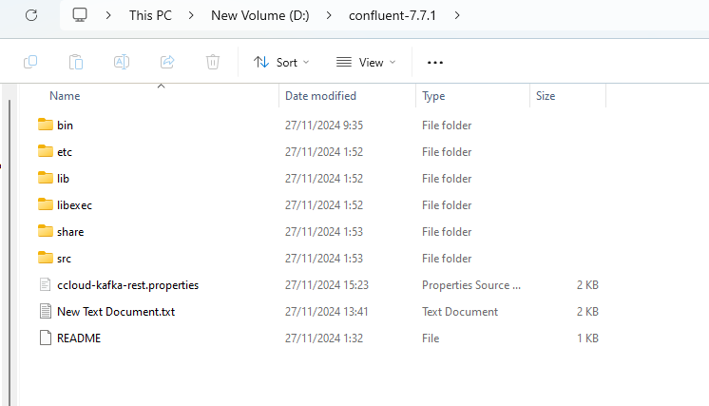
Extract Confluent files, place as u want

Slide 5
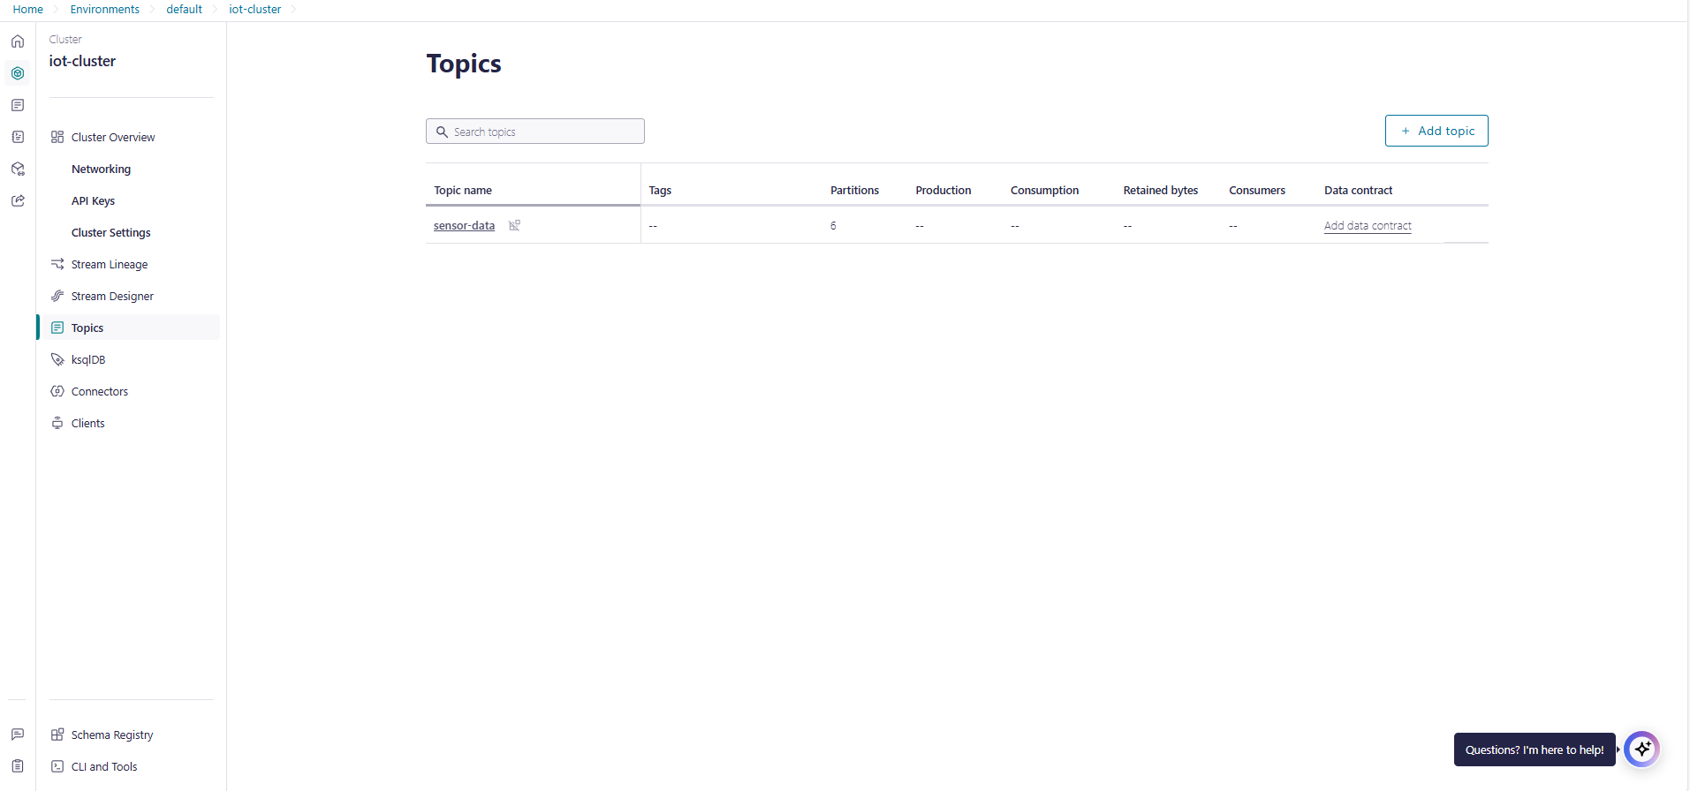
After that back to Confluent Platform and create topic, ive already create named sensor-data

Slide 6
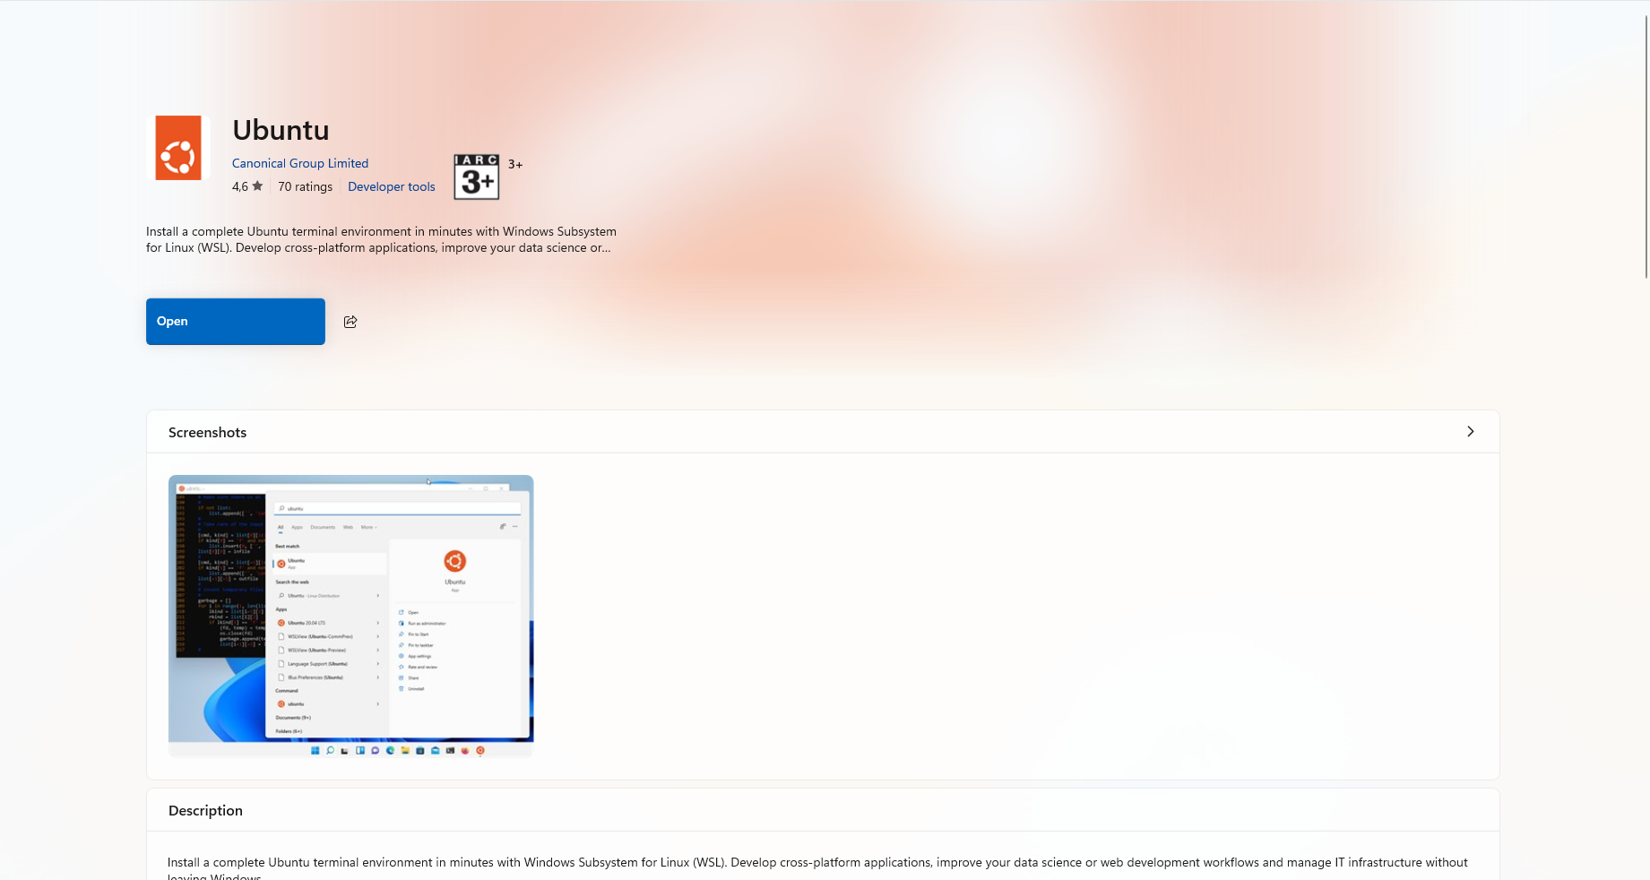
Install Ubuntu for WSL Terminal, and u need configure it

Slide 7
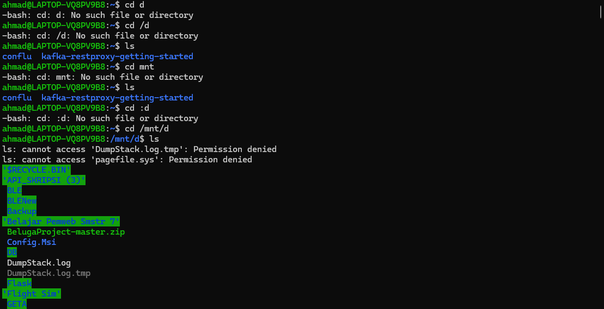
After that move into confluent directory mine is on D

Slide 8
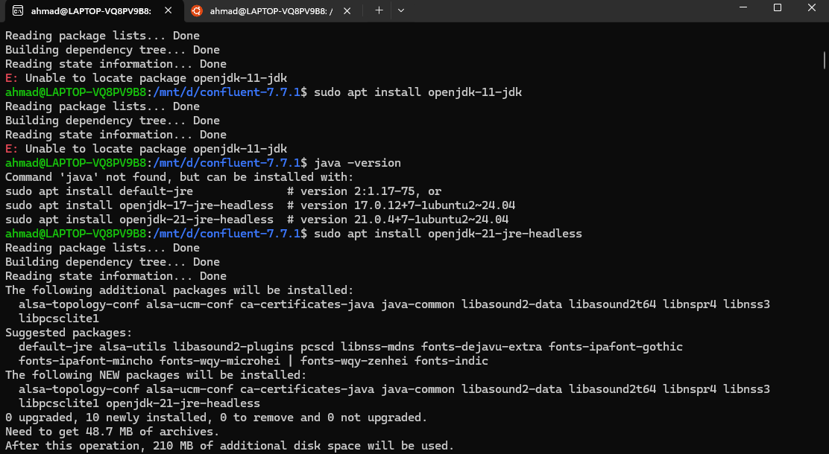
Install Java JDK because confluent need run with java

Slide 9
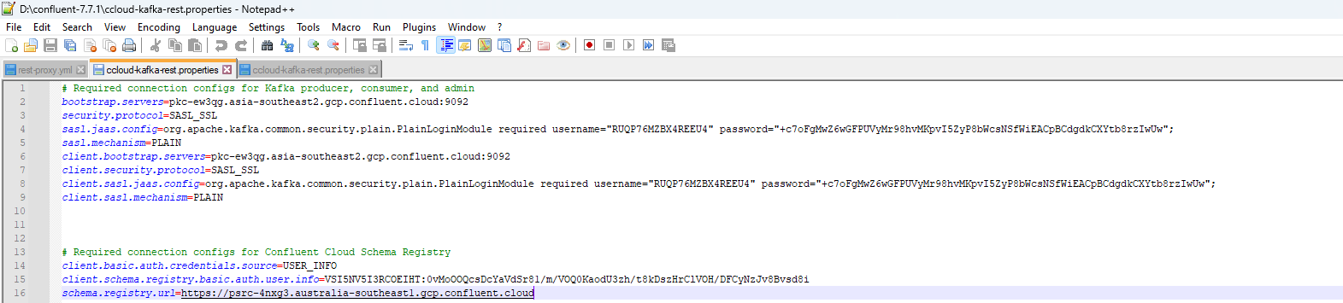
Before Run Rest Proxy u need create ccloud-kafka-rest.properties, ensure change with your own cloud configuration.

Slide 10
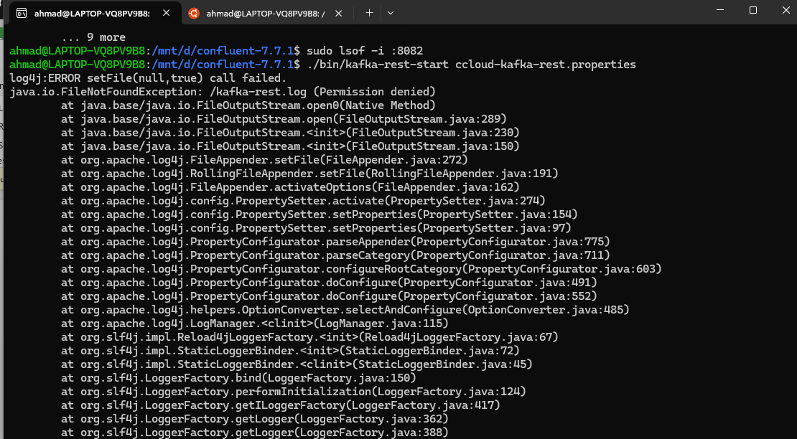
Run Rest Proxy

Slide 11
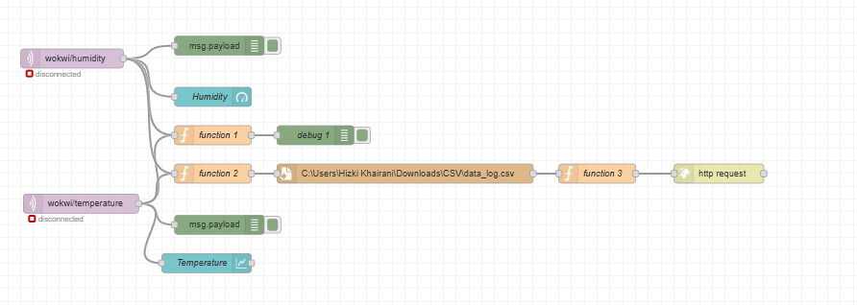
Heres my Node flow

Slide 12
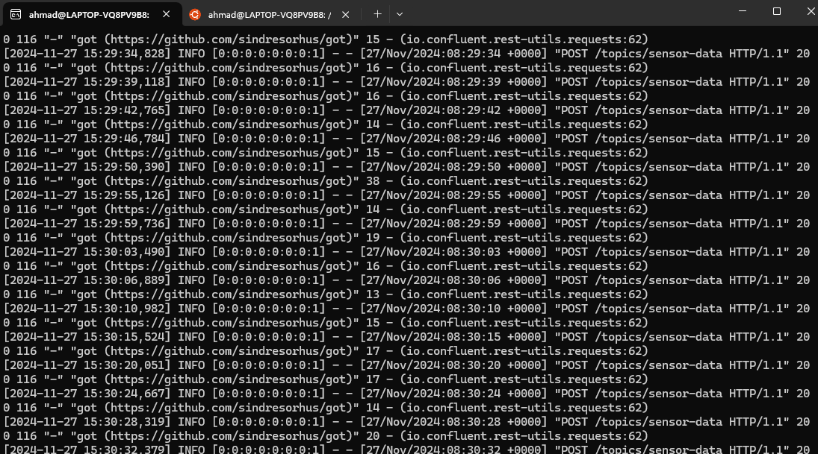
If both integration work, the output will be like this node red sending POST data to kafka
Node red successfully sending data into kafka using rest proxy

Slide 13
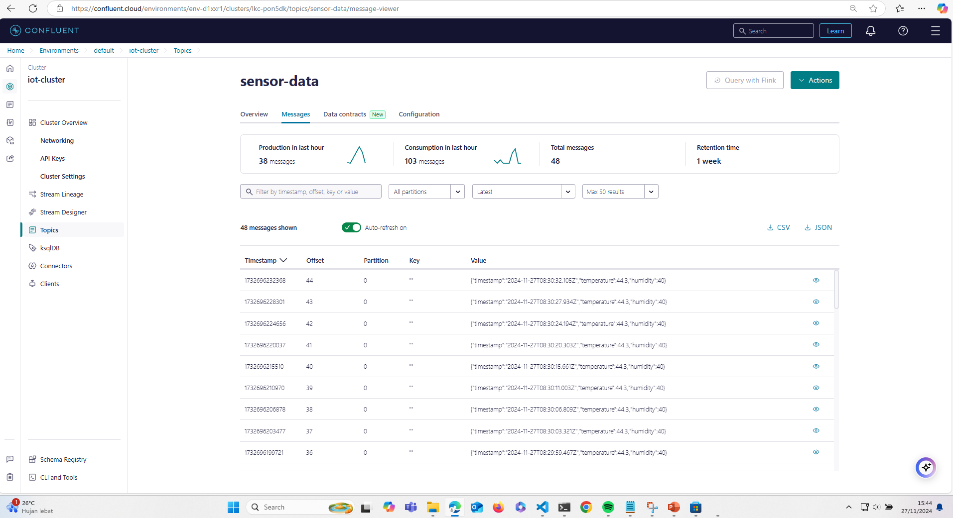
Message History

Slide 14

Thank you
Brita Tamm
502-555-0152
brita@firstupconsultants.com
www.firstupconsultants.com

